Slide 1
Event Grid
March 28, 2019 — 8:30 AM - 5:00 PM | Detroit, Michigan
Learn, architect, and develop solutions on Azure
#AzureDevDays
for developers, by developers
Learn.
Connect.
Explore.

Slide 2

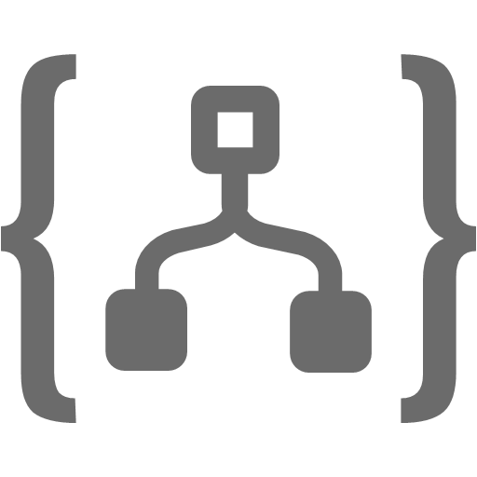

Serverless in Azure
Functions
Logic Apps
Event Grid
Serverless compute
Serverless workflow
Serverless events
Notes:
3 primary services in Azure for serverless.

Slide 3
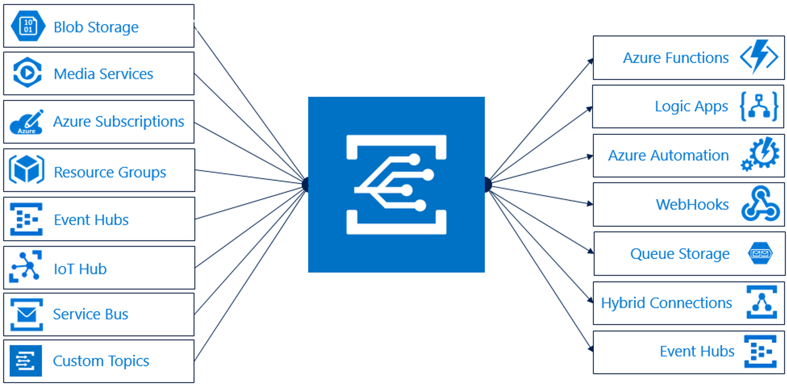
Manage all events in one place
Event Publishers
Event Handlers
Event Topics
Event Subscribers
Notes:
Looking at the end to end flow for Event Grid:
Event publishers raise events when something happens.
Topics are the endpoint where publishers send events.
Event subscriptions are how event handlers receive the events they are interested in.
Event handlers are the app or service reacting to the event.

Slide 4
Event Grid capabilities
Send events to specific event handlers
Send one event to multiple event handlers
Reliably deliver events at scale
Notes:
So why not just use the built in triggers with Functions and Logic apps? What does Event Grid bring to the table?
You can use Event Grid filters to route events to relevant event handlers.
Using a fan-out architecture send one event to as many handlers as needed.
Make sure your events are reliably delivered at large scale with 24 hour retries and support for millions of events.

Slide 5
Pull vs. Push
Has something happened?.
Interested Party
Interested Party
Source of Interest
Interested Party
Has something happened?.
Pull
Yes.
Interested Party
Interested Party
Source of Interest
Something happened.
Interested Party
Push
Notes:
While there are many applications for Event Grid here are two examples of how Event Grid can be used…
Serverless app integration
Event Grid connects your app with other services.
For example, create a custom topic to send your app's event data to Event Grid, and take advantage of its reliable delivery, advanced routing, and direct integration with Azure Functions and Logic Apps to process data anywhere, without writing code.
Automate operations
Event Grid allows you to speed automation and simplify policy enforcement.
For example, Event Grid can notify Azure Automation when a virtual machine is created, or a SQL Database is spun up. These events can be used to automatically check that service configurations are compliant, put metadata into operations tools and tag virtual machines.

Slide 6


Event Distribution & Filtering
Subject: A
Event Hub
Event Grid Topic
API App
Notes:
While there are many applications for Event Grid here are two examples of how Event Grid can be used…
Serverless app integration
Event Grid connects your app with other services.
For example, create a custom topic to send your app's event data to Event Grid, and take advantage of its reliable delivery, advanced routing, and direct integration with Azure Functions and Logic Apps to process data anywhere, without writing code.
Automate operations
Event Grid allows you to speed automation and simplify policy enforcement.
For example, Event Grid can notify Azure Automation when a virtual machine is created, or a SQL Database is spun up. These events can be used to automatically check that service configurations are compliant, put metadata into operations tools and tag virtual machines.

Slide 7
Event Distribution & Filtering
Subject: B
Event Hub
Event Grid Topic
API App
Notes:
While there are many applications for Event Grid here are two examples of how Event Grid can be used…
Serverless app integration
Event Grid connects your app with other services.
For example, create a custom topic to send your app's event data to Event Grid, and take advantage of its reliable delivery, advanced routing, and direct integration with Azure Functions and Logic Apps to process data anywhere, without writing code.
Automate operations
Event Grid allows you to speed automation and simplify policy enforcement.
For example, Event Grid can notify Azure Automation when a virtual machine is created, or a SQL Database is spun up. These events can be used to automatically check that service configurations are compliant, put metadata into operations tools and tag virtual machines.

Slide 8
Event Distribution & Filtering
Subject: *
Event Hub
Event Grid Topic
API App
Notes:
While there are many applications for Event Grid here are two examples of how Event Grid can be used…
Serverless app integration
Event Grid connects your app with other services.
For example, create a custom topic to send your app's event data to Event Grid, and take advantage of its reliable delivery, advanced routing, and direct integration with Azure Functions and Logic Apps to process data anywhere, without writing code.
Automate operations
Event Grid allows you to speed automation and simplify policy enforcement.
For example, Event Grid can notify Azure Automation when a virtual machine is created, or a SQL Database is spun up. These events can be used to automatically check that service configurations are compliant, put metadata into operations tools and tag virtual machines.

Slide 9



Messaging in Azure
Storage Queues
Service Bus
Event Hubs
Event Grid
Simple Queues
Background Processing
Enterprise Messaging
Ordered Delivery
De-Duplication
Big Data Streaming (Fan-In)
Messaging at Scale
Reactive Eventing (Fan-Out)
Filtering & Routing
Multiple Subscribers
Push Model
Notes:
When we discuss Azure services in the integration space and more specifically in the messaging space, we are generally talking about these four services, Storage queues, Service Bus, Event Hubs, and Event Grid. IoT Hubs would also be in this list, but for the sake of this discussion, we will limit to Event Hubs.
Storage queues came first and gave us the ability to load level using background process with a simple queueing mechanism.
Service Bus then offered us enterprise grade messaging scenarios, with ordered delivery, transaction consistency, de-duplication, etc. It also offered fidelity with on-prem Service Bus for Windows Server.
Event Hubs offer receiving and consuming telemetry and events messages at scale. Strict ordering, repeatable reads are just a few of the characteristics it brought.
Now, there is Event Grid which brings reactive eventing to our serverless offerings. It offers simple filtering and routing, multiple subscribers, and maybe most uniquely a push model.

Slide 10


Event Grid in Comparison
 | Storage Queues | Service Bus | Event Hubs | Event Grid
Transactions/Atomicity
Ordering guarantee
Delivery Guarantee | At least Once | At least Once, At Most Once | At least Once | At least Once
Read | Pull/Destructive | Pull/Destructive | Pull/Repeatable | Push
Peek |  |  | Repeatable reads
Batch Send
Batch Receive
Filtering/Routing |  | Advanced |  | - Simple
In flight transformation
Message Size | 64 KB | 256KB – 1 MB | 256 KB | 64 KB
De-duplication
Notes:
As we drop down into the individual feature comparison of these services, here are just some of the differences we see. Note, these are not all of the feature comparisons that can be made.
*** Walk through table, highlighting the services that offer the feature of the differences between how they off the feature. ***

Slide 11
Benefit from broad coverage
Event Publishers
Event Handlers
Immediately available
Immediately available
Blob Storage
Container Registry
Azure Functions
Hybrid Connections
Resource Groups
Logic Apps
Microsoft Flow
IoT Hub
Azure Subscriptions
Media Services
Azure Automation
Event Hubs
Service Bus
WebHooks
Custom Events
Media Services
Event Hubs
Storage General-V2
Storage Queues
Coming soon
Azure Automation, Azure Active Directory, API Management, Logic Apps, Azure Data Lake Store, Cosmos DB
Coming soon
Fabric Controller, Service Bus, Azure Data Factory
Notes:
Event Grid provides built-in support for Azure services as both Event Publishers and Event Handlers allowing for rapidly creating event-driven, serverless apps.

Slide 12
Event Grid reliability and scale
Event Grid Stats
Sub-second end-to-end latency in the 99th percentile
24-hour retry with exponential back off for events not delivered
10,000,000 events per second per region
Near real-time
Massive scale-out
High reliability

Slide 13
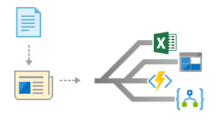
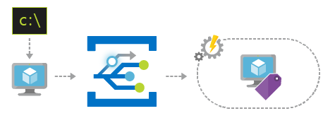
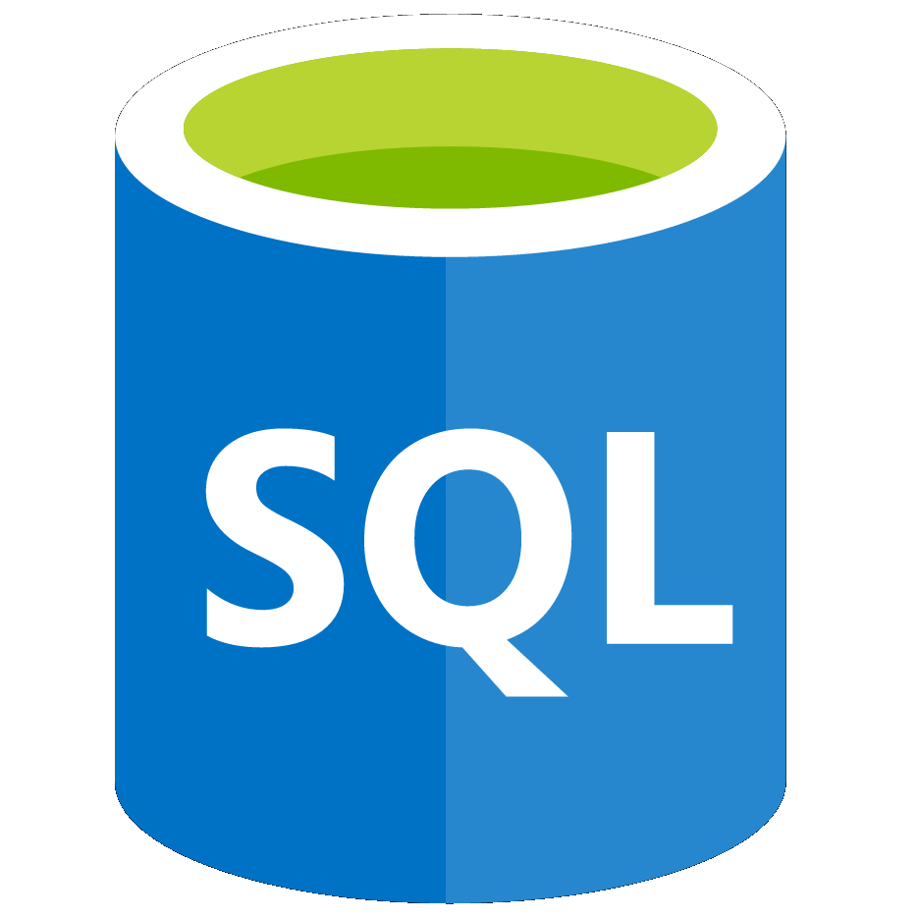
Examples using Event Grid
Serverless app integration
Automate operations
Event Grid connects your app with other services.
Automate and simplify policy enforcement.
Notes:
While there are many applications for Event Grid here are two examples of how Event Grid can be used…
Serverless app integration
Event Grid connects your app with other services.
For example, create a custom topic to send your app's event data to Event Grid, and take advantage of its reliable delivery, advanced routing, and direct integration with Azure Functions and Logic Apps to process data anywhere, without writing code.
Automate operations
Event Grid allows you to speed automation and simplify policy enforcement.
For example, Event Grid can notify Azure Automation when a virtual machine is created, or a SQL Database is spun up. These events can be used to automatically check that service configurations are compliant, put metadata into operations tools and tag virtual machines.

Slide 14
Azure Event Grid
Demo

Slide 15
Event Grid Roadmap
Publishers
Compute
KeyVault
Azure Container Registry
Device Provisioning Service
Azure Data Lake Store
Event Domains
Advanced Filters
String
In/Not in
Beings with/Ends with
Contains
Numerical
In/Not In
Greater than/Less than
Greater than or equal/Less than or equal
Boolean

Slide 17
Optional (time permitting)

Slide 18













Eventing in the cloud
Events
Event Handlers
Blob Storage
Serverless Code
Resource Groups
Functions
Azure Subscriptions
Event Grid
Serverless Workflow and Integration
Event Hubs
CloudEvents Format
Logic Apps
Azure Media Service
Buffering and
Competing Consumers
IoT Hub
Service Bus
Event Hubs
Storage
Queues
Custom Events (anything)
Other Services and Applications
CloudEvents Sources
Hybrid Connections
(WebSockets)
WebHooks (anything)
Azure Automation

Slide 19
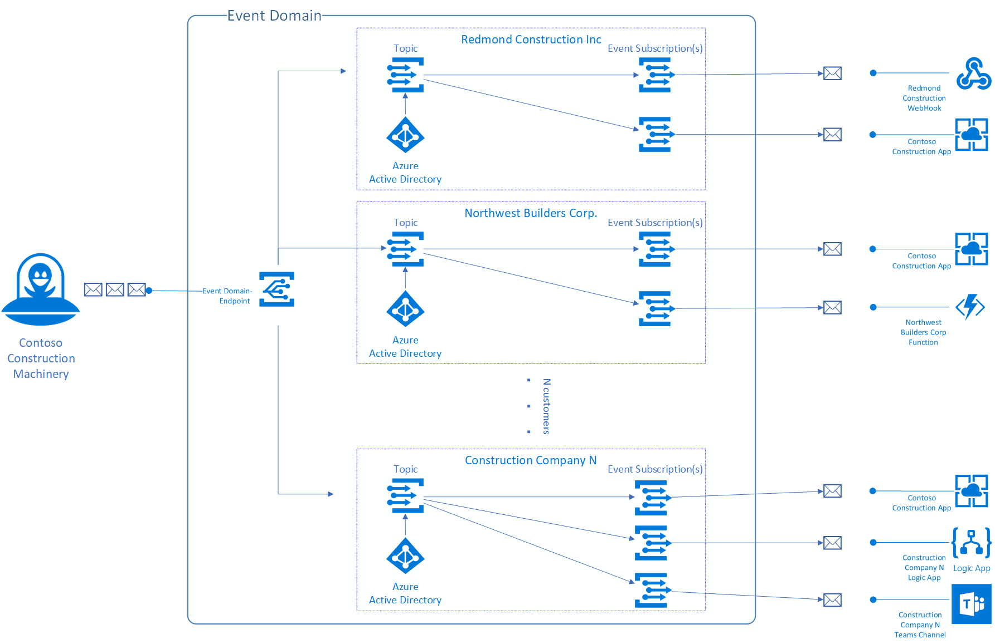
Event Domains

Slide 20
Consumption SDKs
EventGridSubscriber eventGridSubscriber = new EventGridSubscriber();
EventGridEvent[] eventGridEvents = eventGridSubscriber.DeserializeEventGridEvents(requestContent);
Azure subscriptions (management operations)
Container Registry
Blob storage
Event Hubs
IoT Hub
Media Services
Resource groups (management operations)
Service Bus

Slide 21
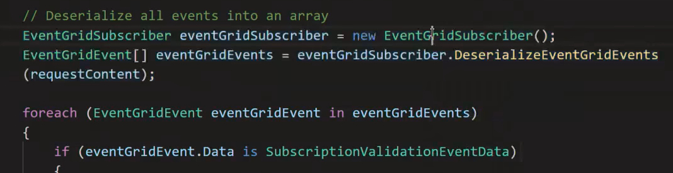
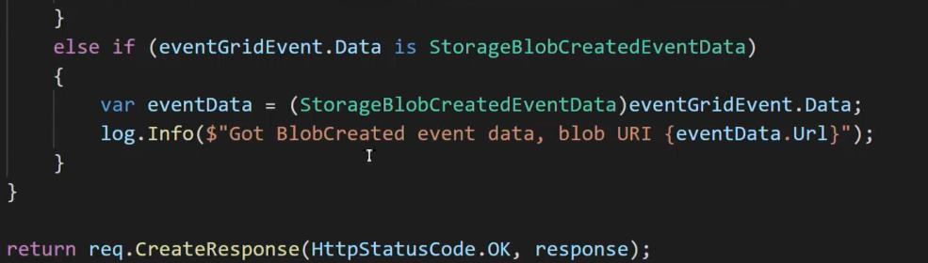
Consumption SDKs

Slide 22
Advanced Filters
Numbers
NumberLessThan
NumberLessThanOrEquals
NumberGreaterThan
NumberGreaterThanOrEquals
NumberIn – the value for data.key equals a value in the set [0, 2.08, 3.14]
NumberNotIn – the value for data.key is not in the set [1, 11, 112, 1124]
Strings
StringContains – the value for data.key contains “the”
StringIn – the value for data.key equals a value in the set [“small”, “brown”, “fox”]
StringNotIn – the value for data.key equals a value in the set [“jumped”, “over”, “the”]
StringBeginsWith – the value for data.key begins with “lazy”
StringEndsWith – the value for data.key ends with “dog”
Boolean
BoolEquals

Slide 23
Example Walkthrough
Architect your solution with queues, grids, and hubs
When to use which and for what?

Slide 24
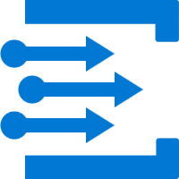

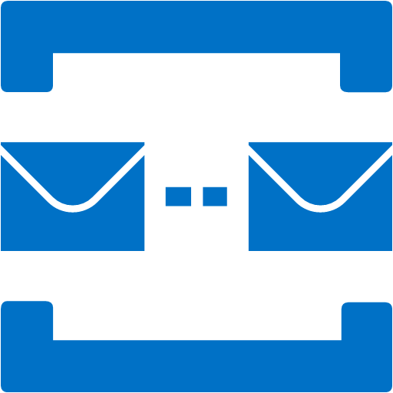

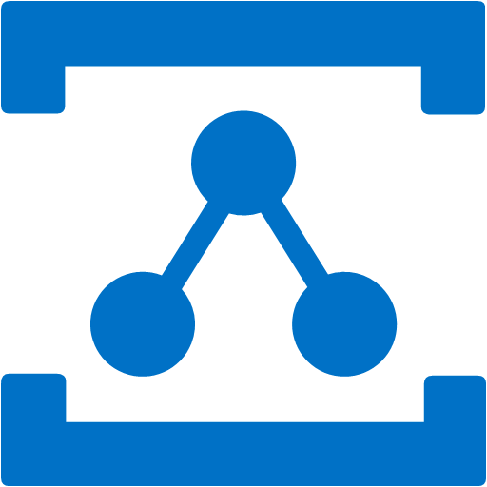
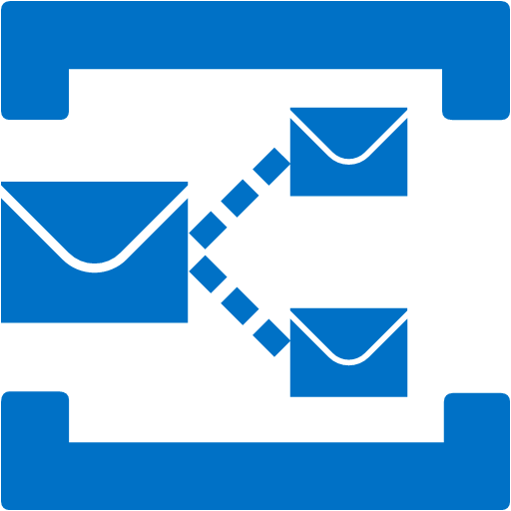
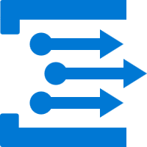
Grid Topic
Event Hubs
Service Bus Queue
Service Bus
Storage Queue
Event Grid
Hybrid Connections
WCF Relay
Service Bus Topic
Grid Subscription

Slide 25
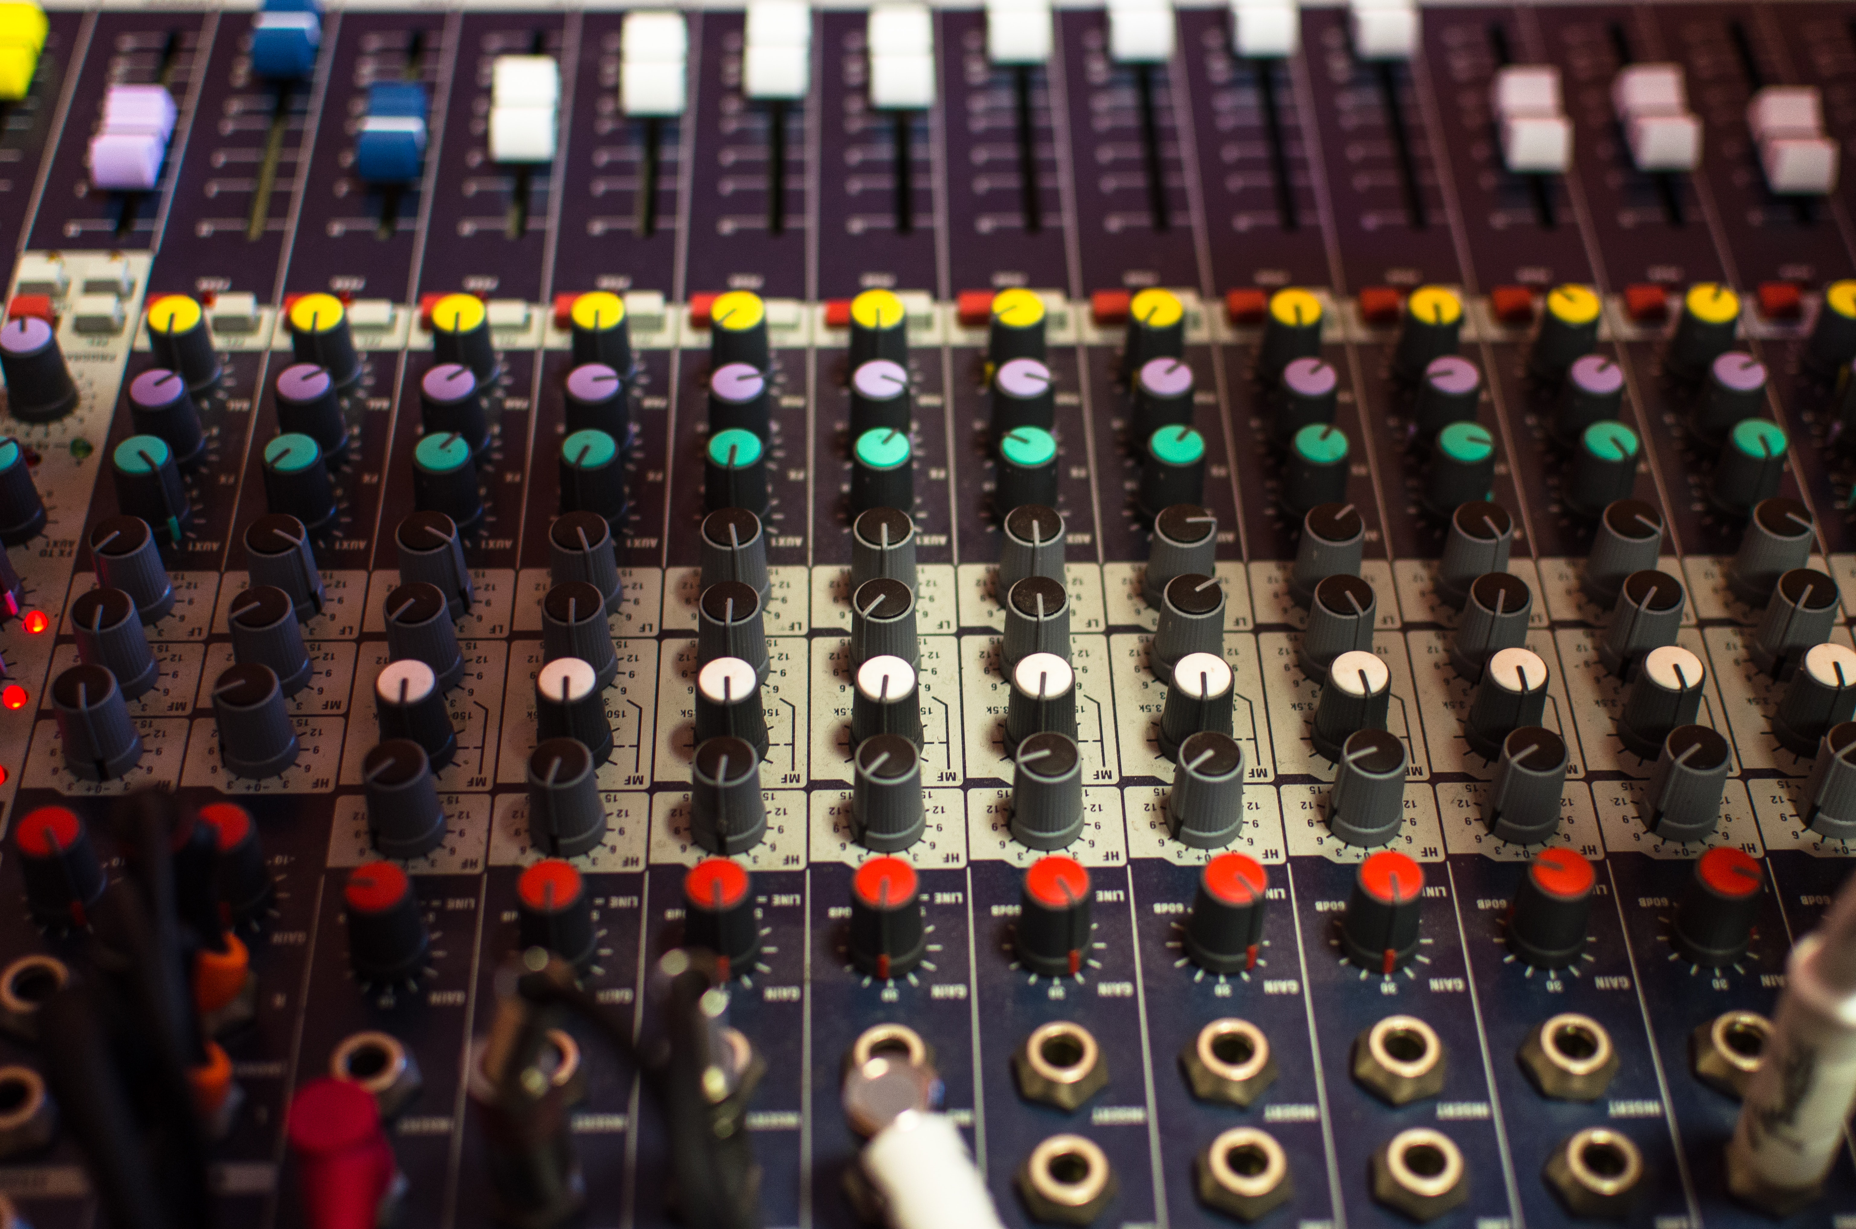
Why do we offer so many messaging products?

Slide 26
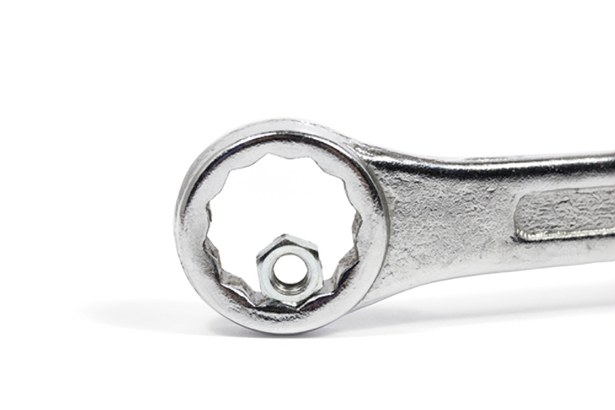
One size does not fit all

Slide 27

Lets build something

Slide 28

Lets build something

Slide 29
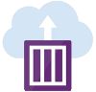




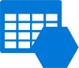

Wind Energy Billing
Container Instance
On-Prem Instance
Event Hubs
Event Grid
Relay
Storage
Service Bus

Slide 30
Hydro Energy Billing
Container Instance
On-Prem Instance
Event Hubs
Event Grid
Relay
Storage
Service Bus

Slide 31

What is a message?

Slide 32


Facts
Commands

Slide 33
Commands

Slide 34





Service Bus
Enterprise messaging
Container Instance
Batch Process
Event Hubs
Event Grid
Relay
Storage
Bill Customer

Slide 35
Facts

Slide 36
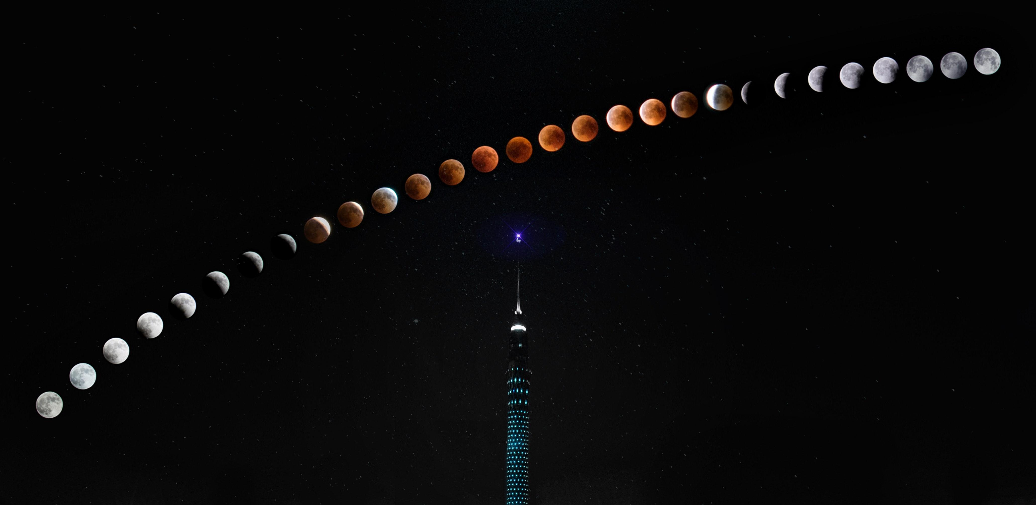

Time series
Discrete

Slide 37
Time series

Slide 38


Event Hubs
Streaming data
Data Producer
Stream Ingestion
On-Prem Instance
Event Grid
Relay
Storage
Service Bus

Slide 39
Discrete

Slide 40
Event Grid
Event based programming
Container Instance
Notification of New Batch
On-Prem Instance
Event Hubs
Relay
Batch Store
Service Bus

Slide 41

Thanks but I have this thing called security

Slide 42
Relay
Connect systems
Container Instance
Connect On-Prem
On-Prem Instance
Event Hubs
Event Grid
Storage
Service Bus

Slide 43
Wind Energy Billing
Data Producer
Stream Ingestion
Notification of New Batch
Connect On-Prem
Batch Process
Batch Store
Bill Customer

Slide 44
Hydro Energy Billing
Container Instance
On-Prem Instance
Event Hubs
Event Grid
Relay
Storage
Service Bus

Slide 45
Cloud messaging domains
Requirement | Simple Queuing | Eventing & PubSub | Big Data Streaming | Enterprise Messaging
Product | Storage Queues | Event Grid | Event Hubs | Service Bus
What do you care about | Communication within an app Individual message Queue semantics / polling buffer Simple and easy to use Pay as you go | Communication between apps / orgs Individual message Push semantics Filtering and routing Pay as you go Fan out | Many messages in a Stream (think in MBs) Ease of use and operation Low cost Fan in Strict ordering Works with other tools (maybe Kafka?) | Instantaneous consistency Strict ordering JMS Non-repudiation & Security Geo-Replication & Availability Rich features (de-dupe, scheduling, etc.)
What are you willing to sacrifice to get it | Ordering of messaging Instantaneous consistency | Ordering of messaging Instantaneous consistency | Server-side cursor Only Once | Cost Simplicity
Serverless
Big Data
Enterprise

Slide 46
Service Bus
Relay
Enterprise messaging
Connect systems
Event Hubs
Event Grid
Data streaming
Event based programming

